Slide 1
IoT Project with STM32WLE5CBU6 and STM32WB55
General Items
LoRa 902 MHz RX, BW=2 kbit/s
LoRa 928 MHz TX, BW=100 kbit/s
Bluetooth communication with app phone (https://wiki.st.com/stm32mcu/wiki/Connectivity:BLE_smartphone_applications) [Display GPS coordinates on map/list in a phone]

Slide 2
Project Description
The project consist of three different boards: The TX board, the Relay board and the Base station
An application for a iOS and Android needs to be developed (can be done with another freelancer)
The TX board includes one STM32wle5cbu6 MCU with a GNSS Quectel Module L86. This board will only communicate with the relay board. This board is battery power therefore is critical to enter in STOP 2 mode to save energy. This board should be as small possible such as 35 x 25 mm. The battery shall not exceed 400 mAh. This board will wake up everyday at 8 AM, receive the GNSS signal, correct/update the RTC value and after it will turn ON RX to listen for “Hello” signal from the relay signal. In order to save battery, the RX will be ON for two hours and will be only checking for the Hello signal for 5 s every 30 s i.e. the RX will be ON for 5 seconds and it will go into STOP2 for 25 and again 5 seconds RX ON waiting for the “Hello” signal. LORA 902 MHz, minimum bandwidth 2 kbits
Example: TX board will be ON from June to November, wake up everyday at 8 AM, update the RTC with the new data given by the GNSS module and 5 seconds listens for the relay signal and if it doesn’t receive the Hello signal then sleeps for 25 seconds. Then it wakes up check for 5 seconds for the hello signal and if it doesn’t hear the ”Hello” signal then goes into sleep again for 25 seconds.
The Relay Board includes two STM32wle5cbu6 MCU. This board will communicate with the multiple TX boards and the base station (there will be only one base station). This board can consume as much energy as required because it will be powered for a few hours; however, the size should be no large than 50 x 30 mmm. The relay board will send the acquired data from the TX boards to the base station board as soon as the GPS coordinates arrive. LORA 902 MHz, 250 kbits bandwidth
Base Station: includes one STM32wle5cbu6 MCU and a MCU with Bluetooth communication capabilities. This board will communicate with the relay board and a smartphone via Bluetooth. The base station will be listening for the data from the relay board and as the data arrives it will be send to the smartphone via Bluetooth
APP: The app will display on a map the location of the GPS coordinates.

Slide 3
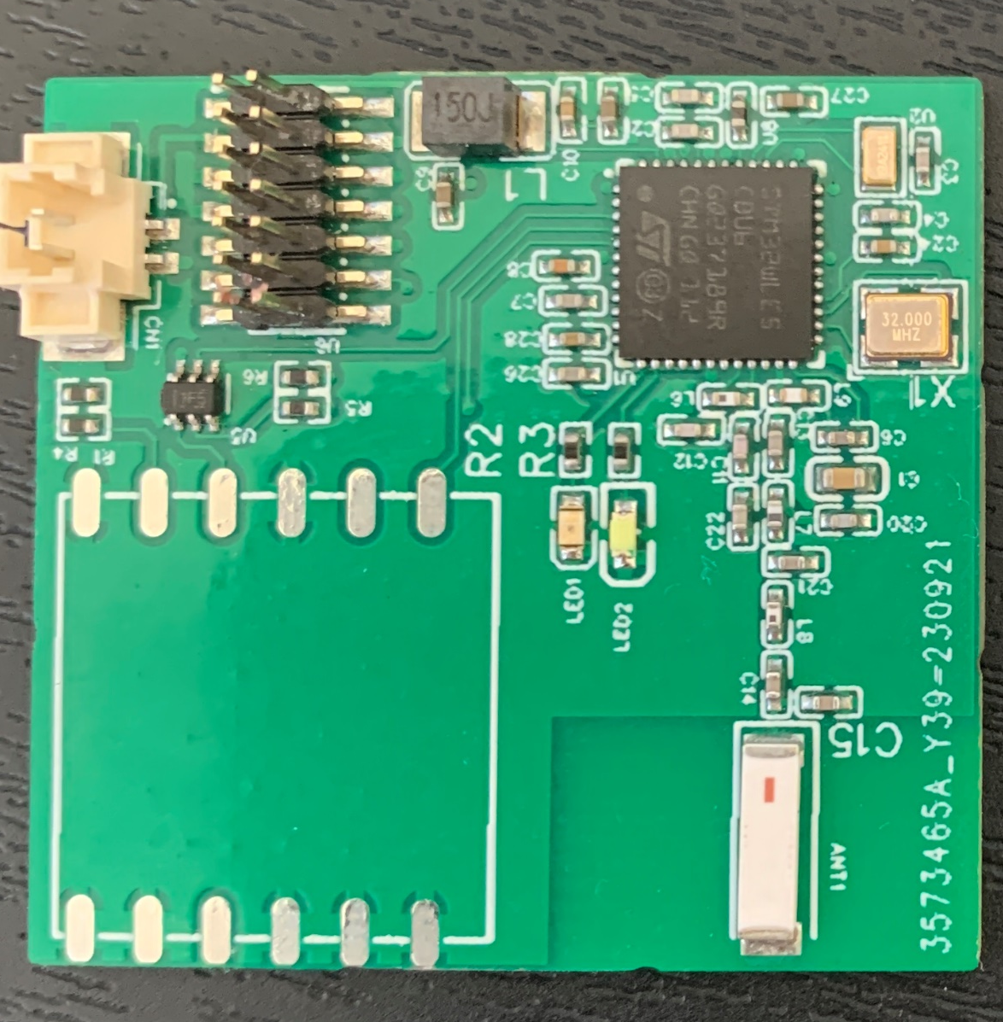
STM32wle5cbu6
Overall view of all devices
SmartPhone
Phone App which displays GPS coordinates on a map (or on a list). STM has an app
25 mm
Data sent by TX Boards: ID+ GPS data
QUECTEL L86
Antenna 902 MHz
“Hello” and Shut off signal sent from Relay Board
Bluetooth
35 mm
STM32wle5cbu6
Relay board
LoRa 928 MHz
LoRa 928 MHz
Receiver with Bluetooth board
LoRa 902 MHz
Bluetooth
UART
UART
ESP32-C3
Or similar Bluetooth MCU
STM32wle5cbu6
STM32wle5cbu6
STM32wle5cbu6
QUECTEL L86
Antenna 902 MHz
Relay board sends to the base station the GPS location of TX Boards with IDs
Board Not developed
Not developed
Multiple TX boards with LoRaWAN
Base Station

Slide 4
State machine for TX board
July 1st at 8 AM
Turns on GNSS module, Obtains new data
Valid signal from GNSS received; if it exceeds 30 seconds use previous location coordinates
First time power ON. It can happen anytime in April
Valid GNSS signal from GNSS module
Enable GNSS module to obtain date and time
Everyday at 8 AM
Sleep
Listens for 5 seconds for the Hello signal
If NO signal is received and is past 10 AM then go to sleep
Please create an algorithm to correct to the correct timezone. GNSS module works with UTC
NO signal received
If more than 30 seconds pass then go to sleep
Hello signal received
Transmit GNSS coordinates with ID
Sleep for 25 seconds
Listen for shut off signal from relay board

Slide 5
State machine for Relay Board
Listen for 8 seconds for GNSS coordinates
GNSS coordinate is received
Sending Hello every 10 seconds
Store in RAM memory
Send Shut off signal to that TX Board
Transmit data to other MCU
OTHER STM32WLE CBU6 MCU
Transmit GNSS coordinates with ID to base station

Slide 6
State machine for Base Station Board
Send data to Bluetooth MCU
Bluetooh MCU
Listen for data from relay board
Send data to smartphone app thru Blueooth

Slide 7
Logistics:
I’m shipping from JLCPCB in Mainland China, 4 layer layout the board goes to you and me so that we can debug together
Before start programming, let’s put a finite state machine diagram
App: can you develop the app (iPhone or Android)? If so, please provide a budget?
Budget to develop the firmware for the three boards:
Timeline/schedule:
Number of spins (different board prototypes) for the TX board, repeater/relay board and base station:
When is a good to communicate with you?
What is preferred system of communication? WhatsApp, teams?

